Slide 1
Secure Data Hiding in Image Using Steganography
CAPSTONE PROJECT
Presented By: T . SAI HARSHITA
Student Name : T. SAI HARSHITA
College Name & Department : ACE ENGINEERING COLLEGE (ECE Dept)

Slide 2
OUTLINE
Problem Statement
Technology used
Wow factor
End users
Result
Conclusion
Git-hub Link
Future scope

Slide 3
Problem Statement
Steganography is a technique used in cybersecurity to hide information in seemingly ordinary files or messages. It's a form of covert communication that can be used to hide text, images, videos, or audio.
Statement :Securing data by hiding the data inside the image by using steganography technique along with other master tools to ensure the safe authorization of the message by sender and receiver.

Slide 4
Technology used
Libraries used are :
Visual Studio Code
Python(version 3.13)
Technology used:
Windows 11 OS
Reference Images
Git Hub
Open Stego (reference)

Slide 5
Wow factors
What makes this project stand out from other projects?
It hides the very existence of a secret message within another seemingly ordinary file, making it difficult to detect that a message is being transmitted at all with the help of a very natural and casual image .
This also has a partition between encryption and decryption which helps the user to easily access the hidden message instead of working through the whole source code

Slide 6
End users
The end users of the project are:
Education institutions
Business institutions,
Intelligence agencies
The military and defense services
Certified ethical hackers
These all use steganography to embed confidential messages and information in plain sight.

Slide 7
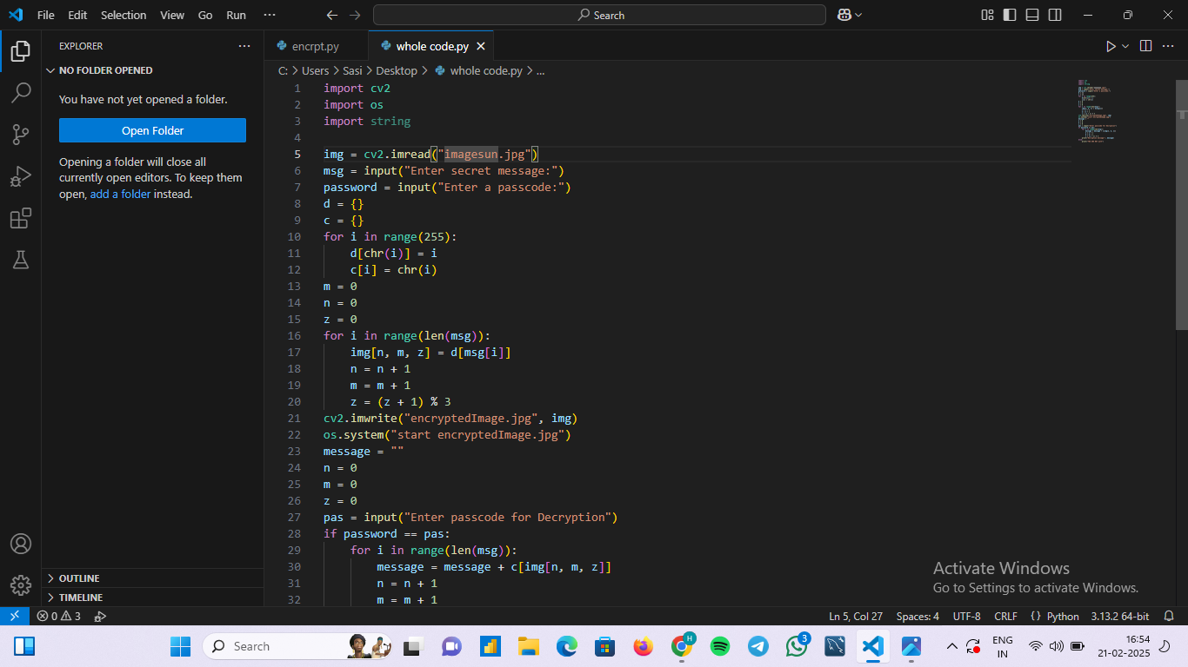

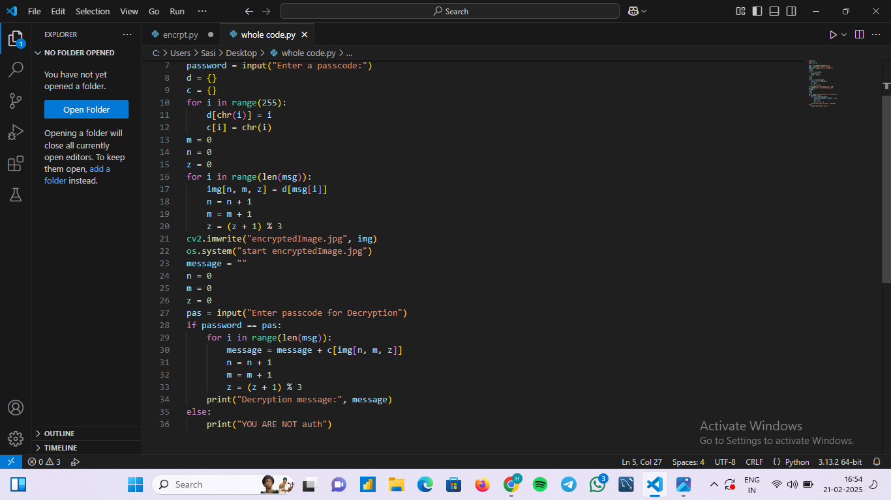
Results
1. SOURCE CODE and IMAGE

Slide 8
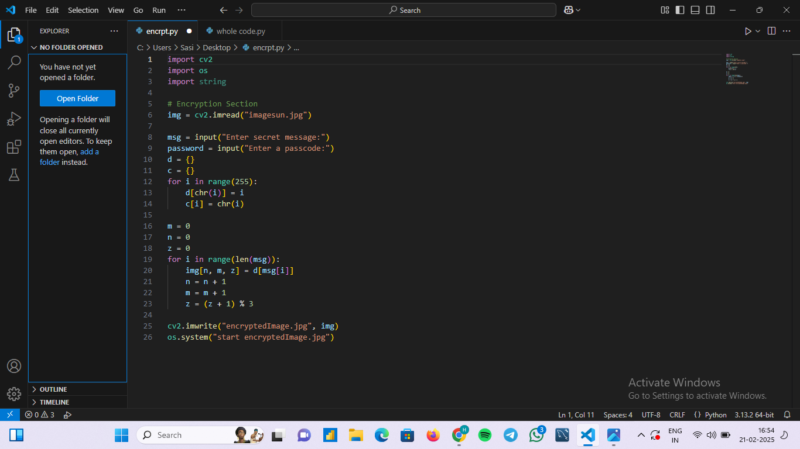
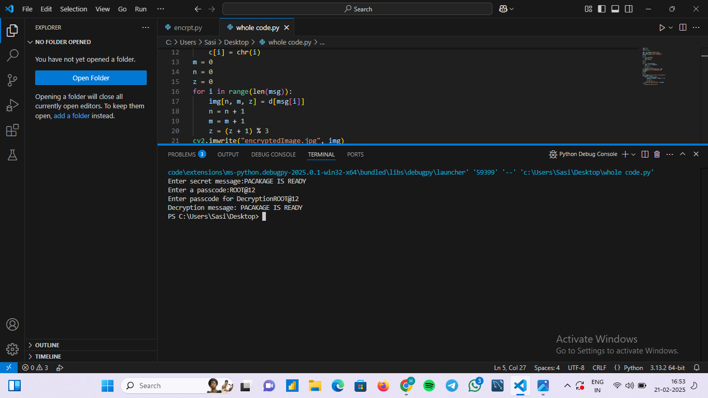

ENCRYPTION CODE AND IMAGE OUTPUT

Slide 9
Conclusion
Statement :Securing data by hiding the data inside the image by using steganography technique along with other master tools to ensure the safe authorization of the message by sender and receiver.
Conclusion: The objective of the statement was to hide a hidden text in the image from sender to receiver with access kept as a password .
The password is the only way to access the file and decrypt the message .This ideology has been implemented practically and achieved.

Slide 10
GitHub Link
https://github.com/sai-harshita-t/Stegnography.git
The above is the link to access the repository.

Slide 11
Future scope(optional)
The future scope of a steganography project lies in developing more robust and sophisticated techniques to embed secret information within various digital media, particularly in areas like advanced security, authentication, quantum computing, digital forensics, and integration with technology, allowing for secure communication and data protection across diverse applications like military, finance, journalism, and intellectual property protection.

Slide 12
THANK YOU

